Slide 1



Vehicle Speed Detection

Slide 2

Learning Objectives
To understand the concept of computer vision and object detection using deep learning models.
To learn how to use Faster R-CNN for detecting and tracking vehicles in video streams.
To apply OpenCV for video processing and frame analysis.
To calculate and estimate vehicle speed based on object tracking and frame rate.
To enhance skills in Python programming, PyTorch, and torchvision libraries.
To gain hands-on experience in developing a real-time vehicle monitoring system.
To understand the applications of AI in intelligent transportation systems.
GOAL
Source :
www.freepik.com/

Slide 3
Tools and Technology used
🧠 Programming & Frameworks
Python – Main programming language for implementation
PyTorch – Deep learning framework for Faster R-CNN model
Torchvision – For pretrained models and image transformations
🎥 Computer Vision
OpenCV – For video capture, image processing, and object tracking
🧰 Development Environment
Jupyter Notebook / VS Code – For writing and testing the code
Google Colab (optional) – For training and running models on GPU
📂 Libraries & Dependencies
NumPy – For numerical operations
Matplotlib – For visualization and plotting results
time & math modules – For speed calculation and timing functions
💾 Dataset
Kaggle / Custom Dataset – For vehicle images and videos used for detection
☁️ Version Control
GitHub – For storing and sharing the source code

Slide 4
Methodology
Data Collection
Gathered video datasets containing moving vehicles (from Kaggle or recorded footage).
Prepared sample videos for model testing and validation.
Preprocessing
Converted video into frames using OpenCV.
Applied resizing and normalization for input to the model.
Object Detection using Faster R-CNN
Loaded a pretrained Faster R-CNN model from Torchvision.
Detected vehicles in each frame with bounding boxes and confidence scores.
Object Tracking
Tracked detected vehicles across consecutive frames using their bounding box coordinates.
Speed Calculation
Calculated speed based on the displacement of vehicles between frames and frame rate (FPS).
Displayed the estimated speed on each detected vehicle in real time.
Output Visualization
Displayed annotated video with bounding boxes, labels, and speed values.
Saved the processed output for analysis and presentation.

Slide 5
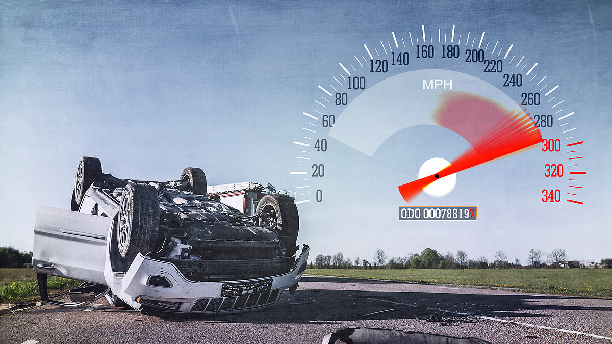
Problem Statement:
In recent years, road accidents and traffic violations have increased due to vehicles overspeeding.
Manual speed monitoring by traffic police is time-consuming, error-prone, and inefficient.
Traditional radar-based speed detection systems are expensive and limited to specific zones.
There is a need for an automated, low-cost, and intelligent system that can detect vehicles and estimate their speeds in real time using computer vision and deep learning.
The project aims to build a Vehicle Speed Detection System that can identify vehicles from video feeds and accurately calculate their speed using object detection models like Faster R-CNN.

Slide 6
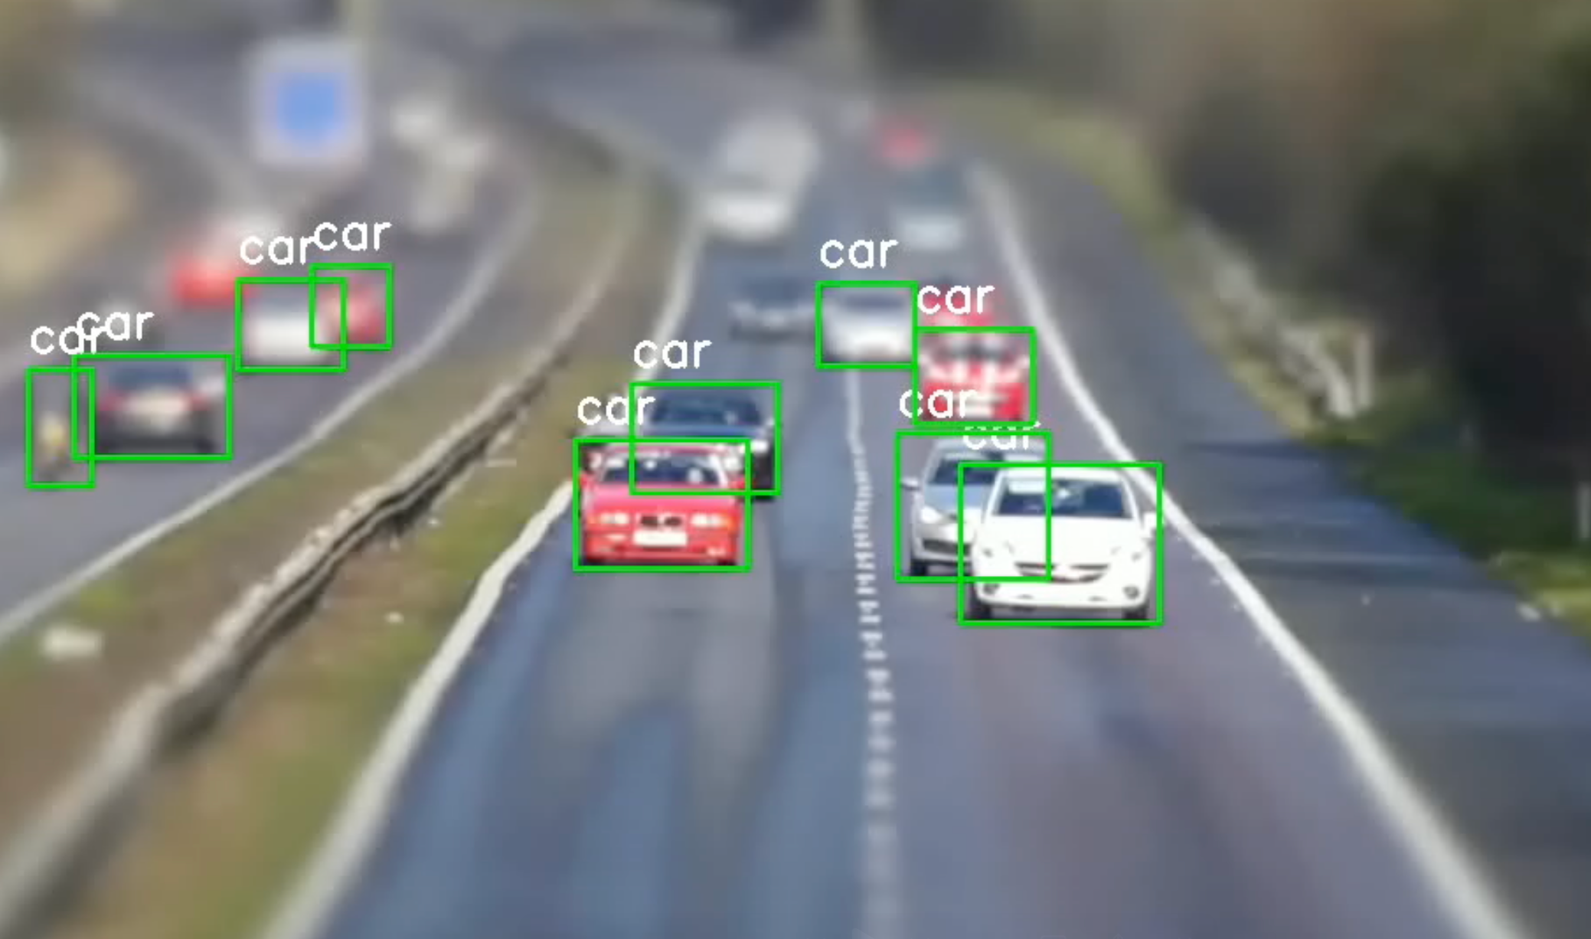
Solution:
Developed an AI-based Vehicle Speed Detection System using Computer Vision and Deep Learning techniques.
Utilized a pre-trained Faster R-CNN model from Torchvision to detect vehicles in real-time video streams.
Implemented OpenCV for video frame extraction, object tracking, and visualization.
Calculated vehicle speed based on the movement of bounding boxes across frames and the video frame rate (FPS).
Designed a real-time system capable of analyzing both live camera feeds and recorded videos.
The system provides an accurate, automated, and cost-effective alternative to traditional radar-based methods for traffic monitoring.

Slide 7
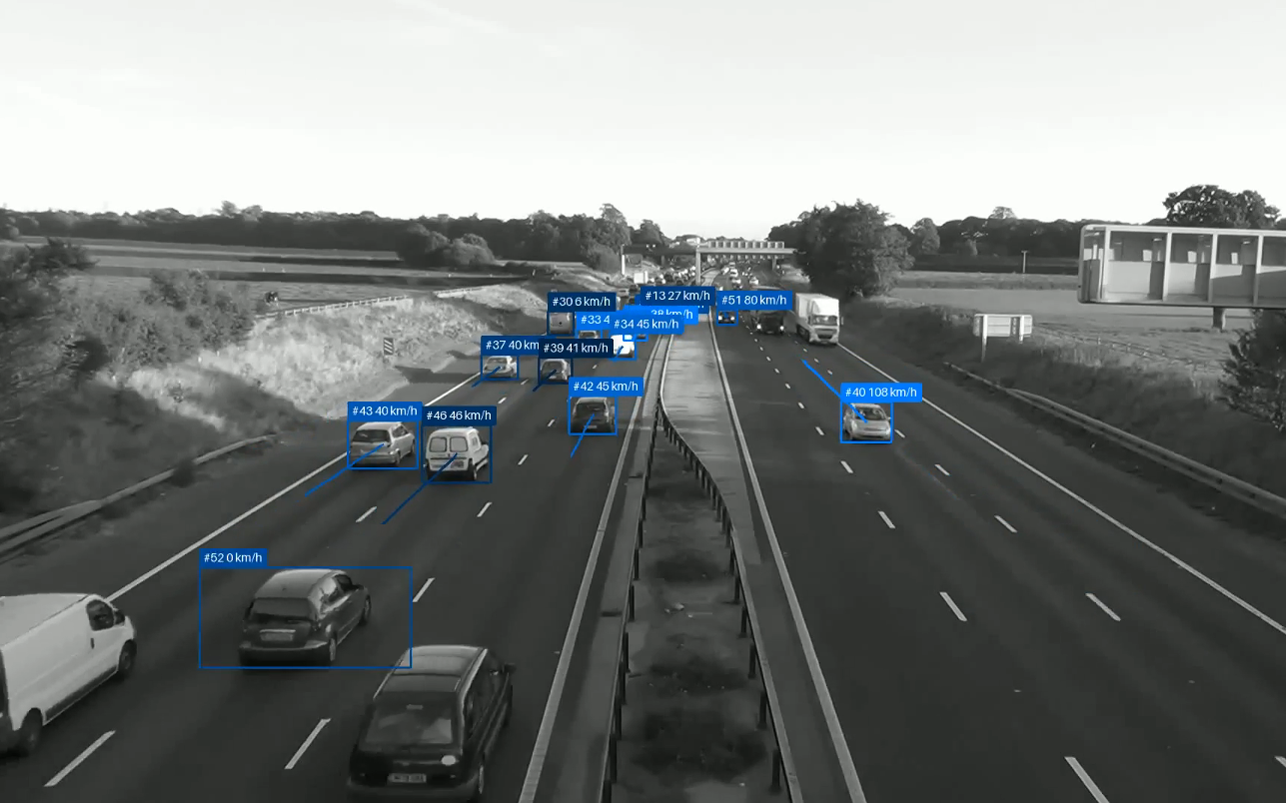
Screenshot of Output:

Slide 8
Conclusion:
The project successfully demonstrates an AI-based system for detecting vehicles and estimating their speed using Computer Vision and Deep Learning.
By leveraging Faster R-CNN and OpenCV, the system achieves accurate detection and real-time speed measurement from video feeds.
The approach provides a cost-effective, automated, and scalable solution for intelligent traffic monitoring and law enforcement.
This project highlights the potential of machine learning in smart transportation systems, contributing to improved road safety and traffic management.
Future enhancements can include multi-lane tracking, license plate recognition, and integration with IoT-based smart city systems.

